Slide 1

Crazy about
(OpenStreet)Mapping

Slide 2
Who am I?
Pieter Vander Vennet
Studied informatics
Heavy OSM-contributor
Working for a small company on mobility (with OSM)
Bit crazy about mapping and OSM…
… I’ll tell you why

Slide 3
What is
OpenStreetMap?

Slide 4


Slide 5


Slide 6
What is
OpenStreetMap?

Slide 7
Geospatial data

Slide 8
Geospatial data
Lines and dots
+
Some information
on each line and dot

Slide 9
What is
OpenStreetMap?

Slide 10

Freedom to add data

Slide 11
Freedom to add data
As long as it is verifiable on the ground

Slide 12
Freedom to add data
As long as it is verifiable on the ground
As long as no copyright is infringed

Slide 13
Freedom to add data
As long as it is verifiable on the ground
As long as no copyright is infringed
Go add your specific needs!

Slide 14

How can YOU edit?

Slide 15
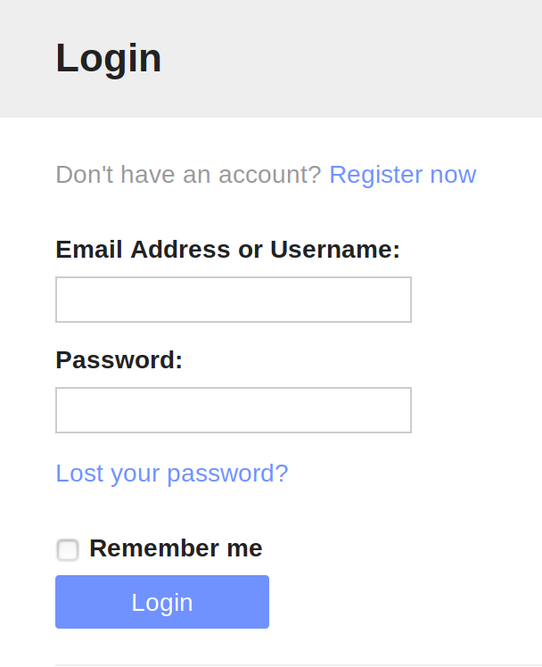
How can YOU edit?

Slide 16
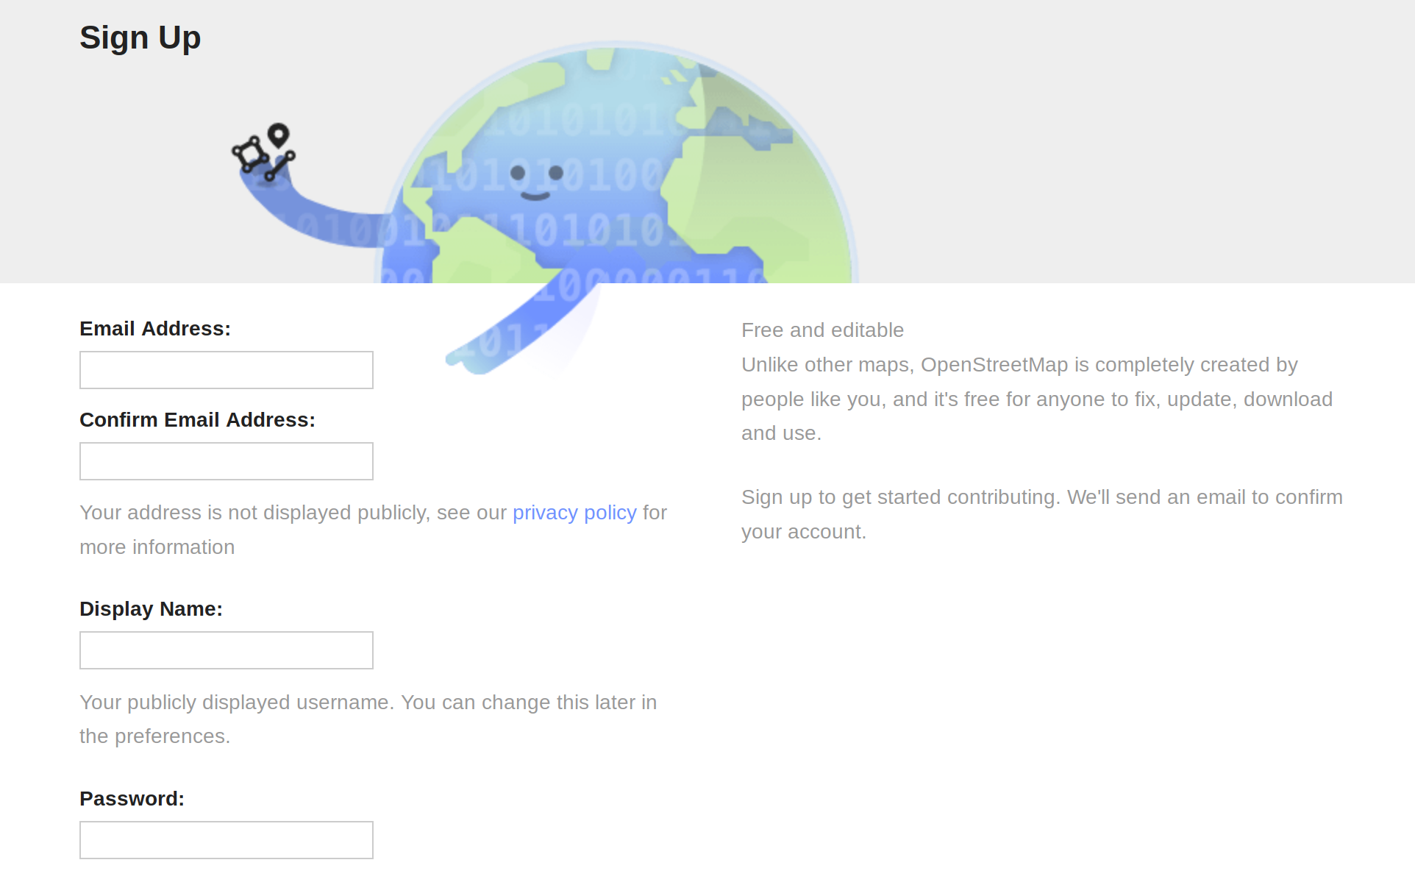
How can YOU edit?

Slide 17
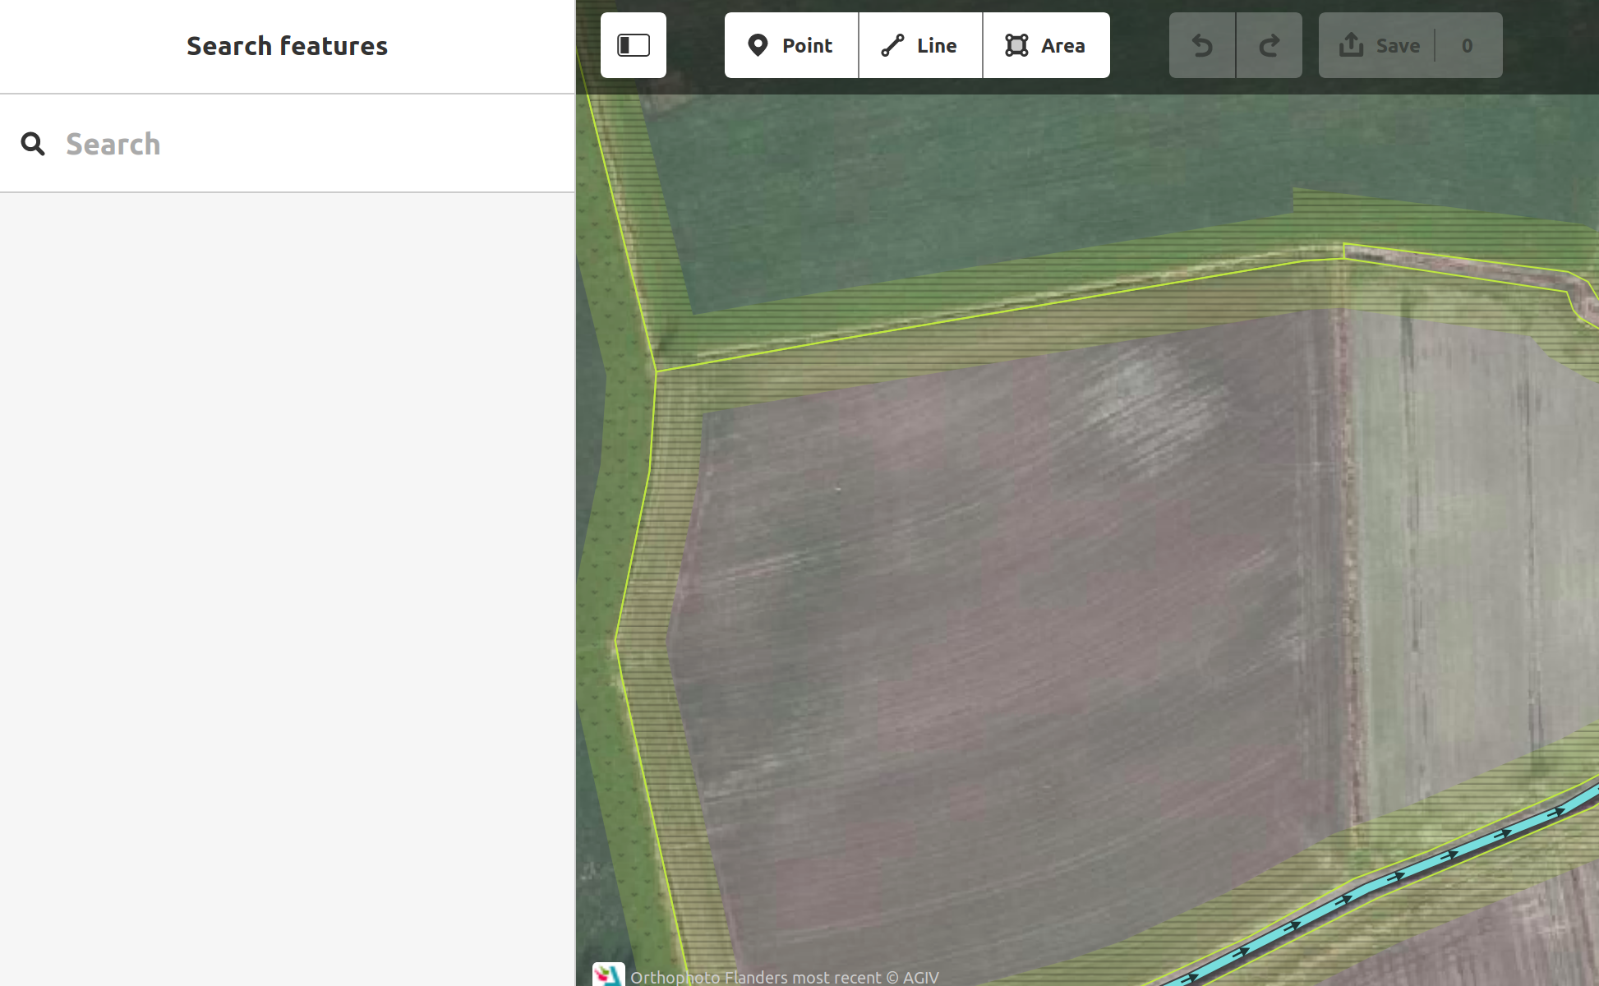
How can YOU edit?

Slide 18
What is
OpenStreetMap?

Slide 19
Crowdsourced

Slide 21


Slide 22


Slide 23


Slide 24


Slide 25


Slide 26


Slide 27
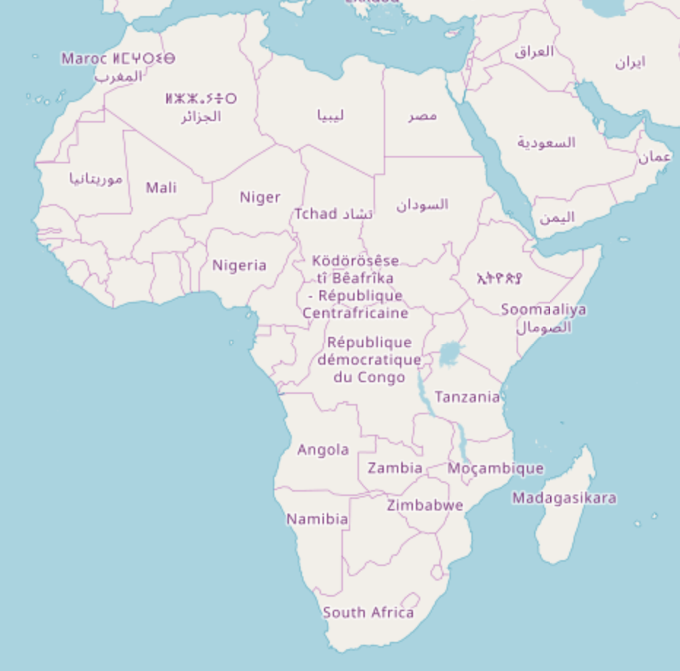

Slide 28


Slide 29



Slide 30
What is
OpenStreetMap?

Slide 31
Saving lives

Slide 32
Come to a mapathon
Osm.be/calendar
Every now and then, we get together and map
Next one: Rode Kruis, 7th may

Slide 33
What is
OpenStreetMap?

Slide 34

A license: ODbL
Open Database License
You can use the data how you like
as long as you give attribution
and keep the data open

Slide 35
Tons of apps, websites, ...

Slide 36




OsmAnd

Slide 37
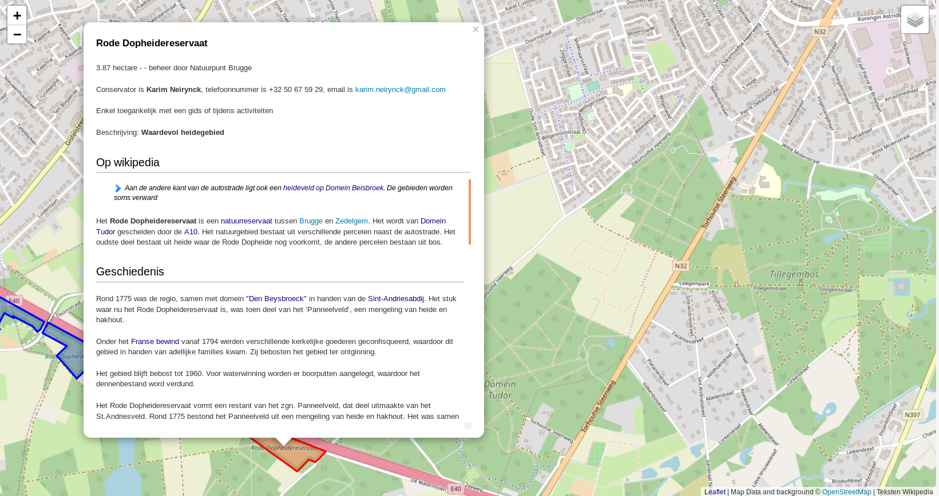


Slide 38


Slide 39


Slide 40
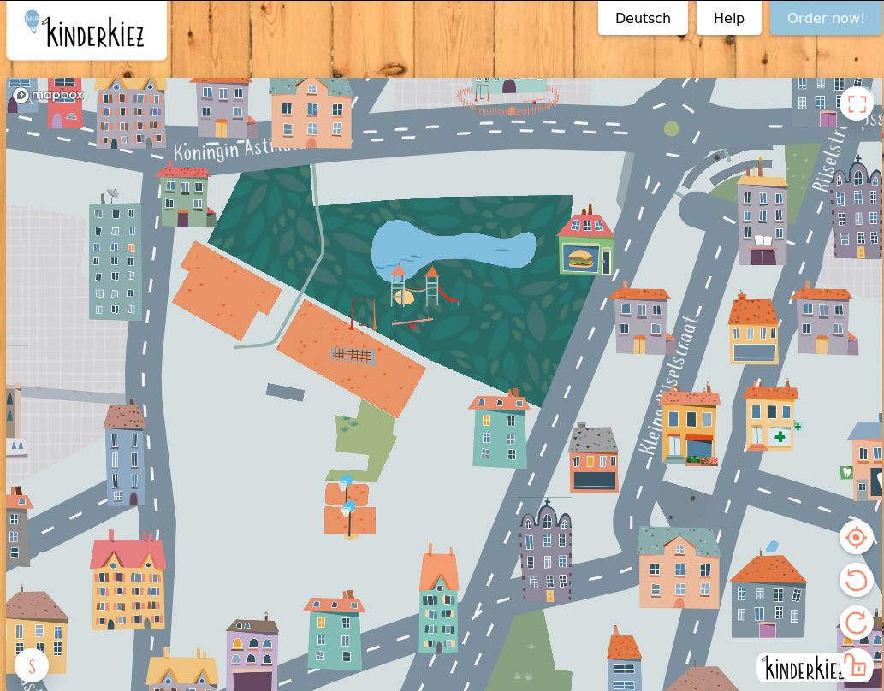

Slide 41
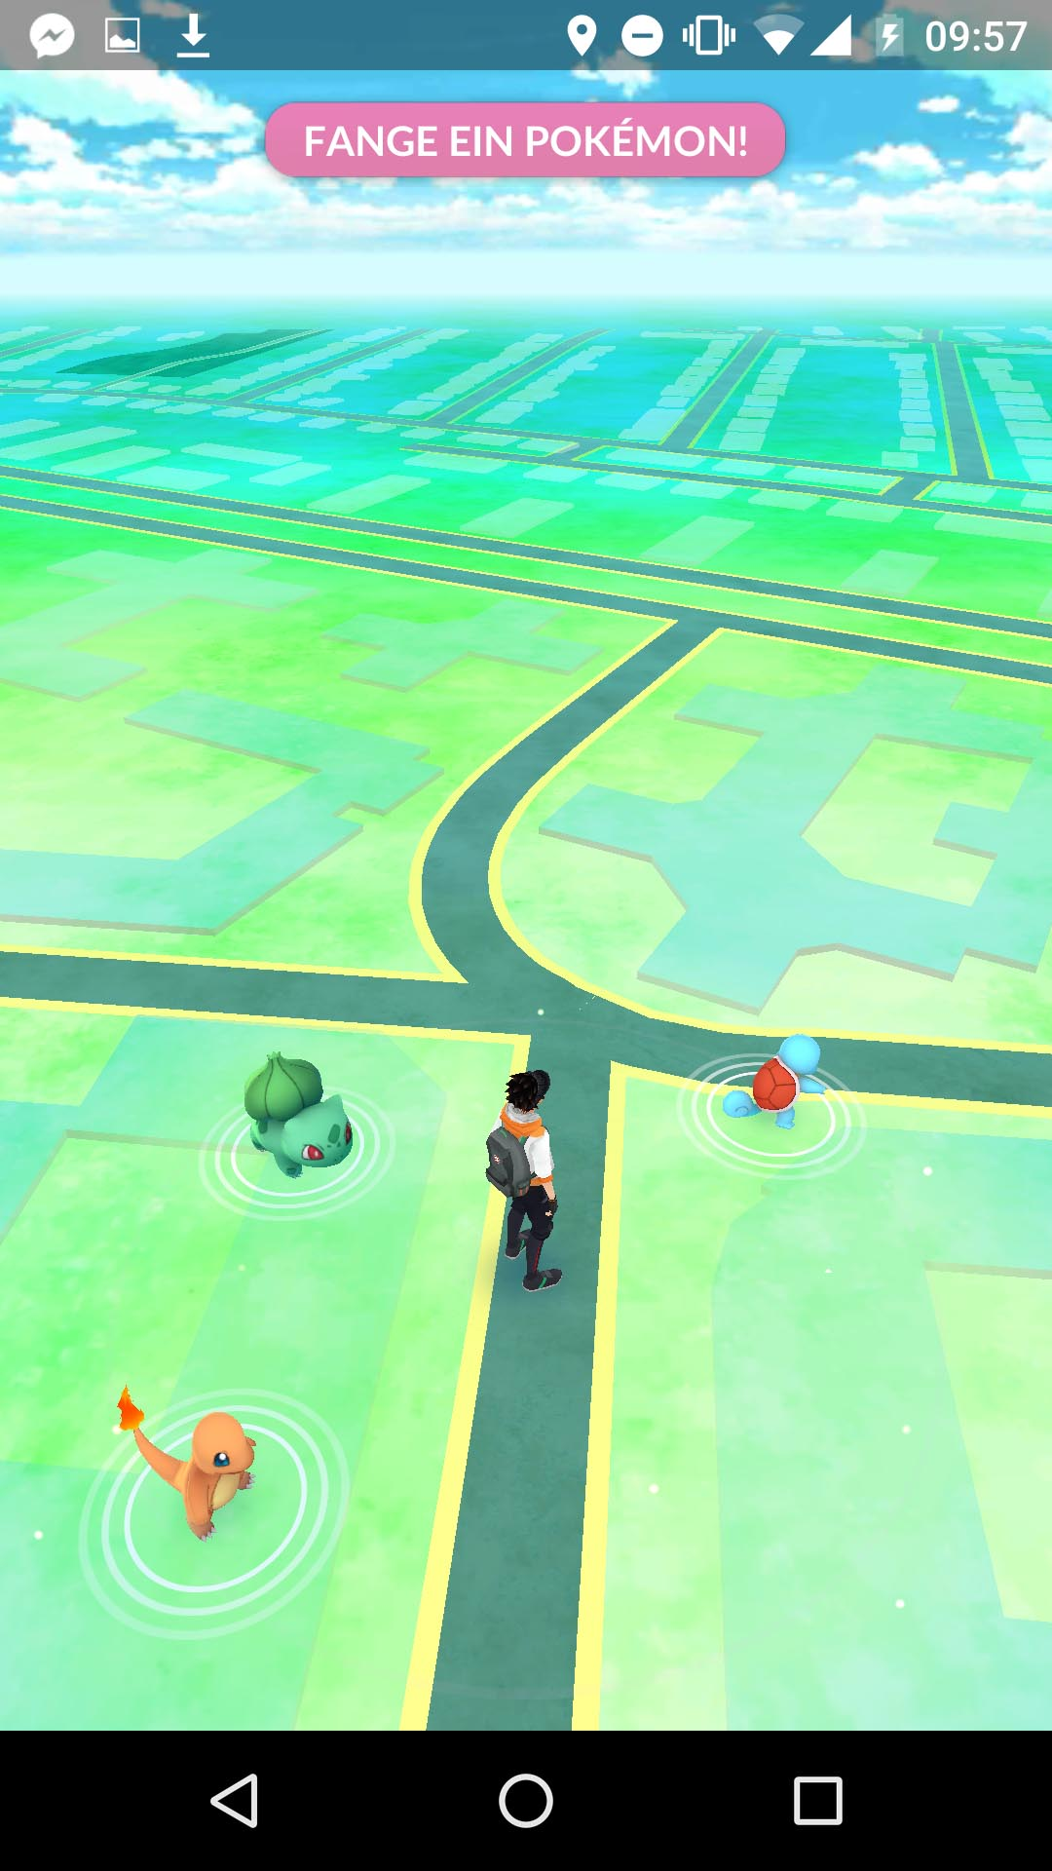

Slide 42

Szell, M. (2018). Crowdsourced Quantification and Visualization of Urban Mobility Space Inequality. Urban Planning, 3(1), 1-20. doi:http://dx.doi.org/10.17645/up.v3i1.1209

Slide 43
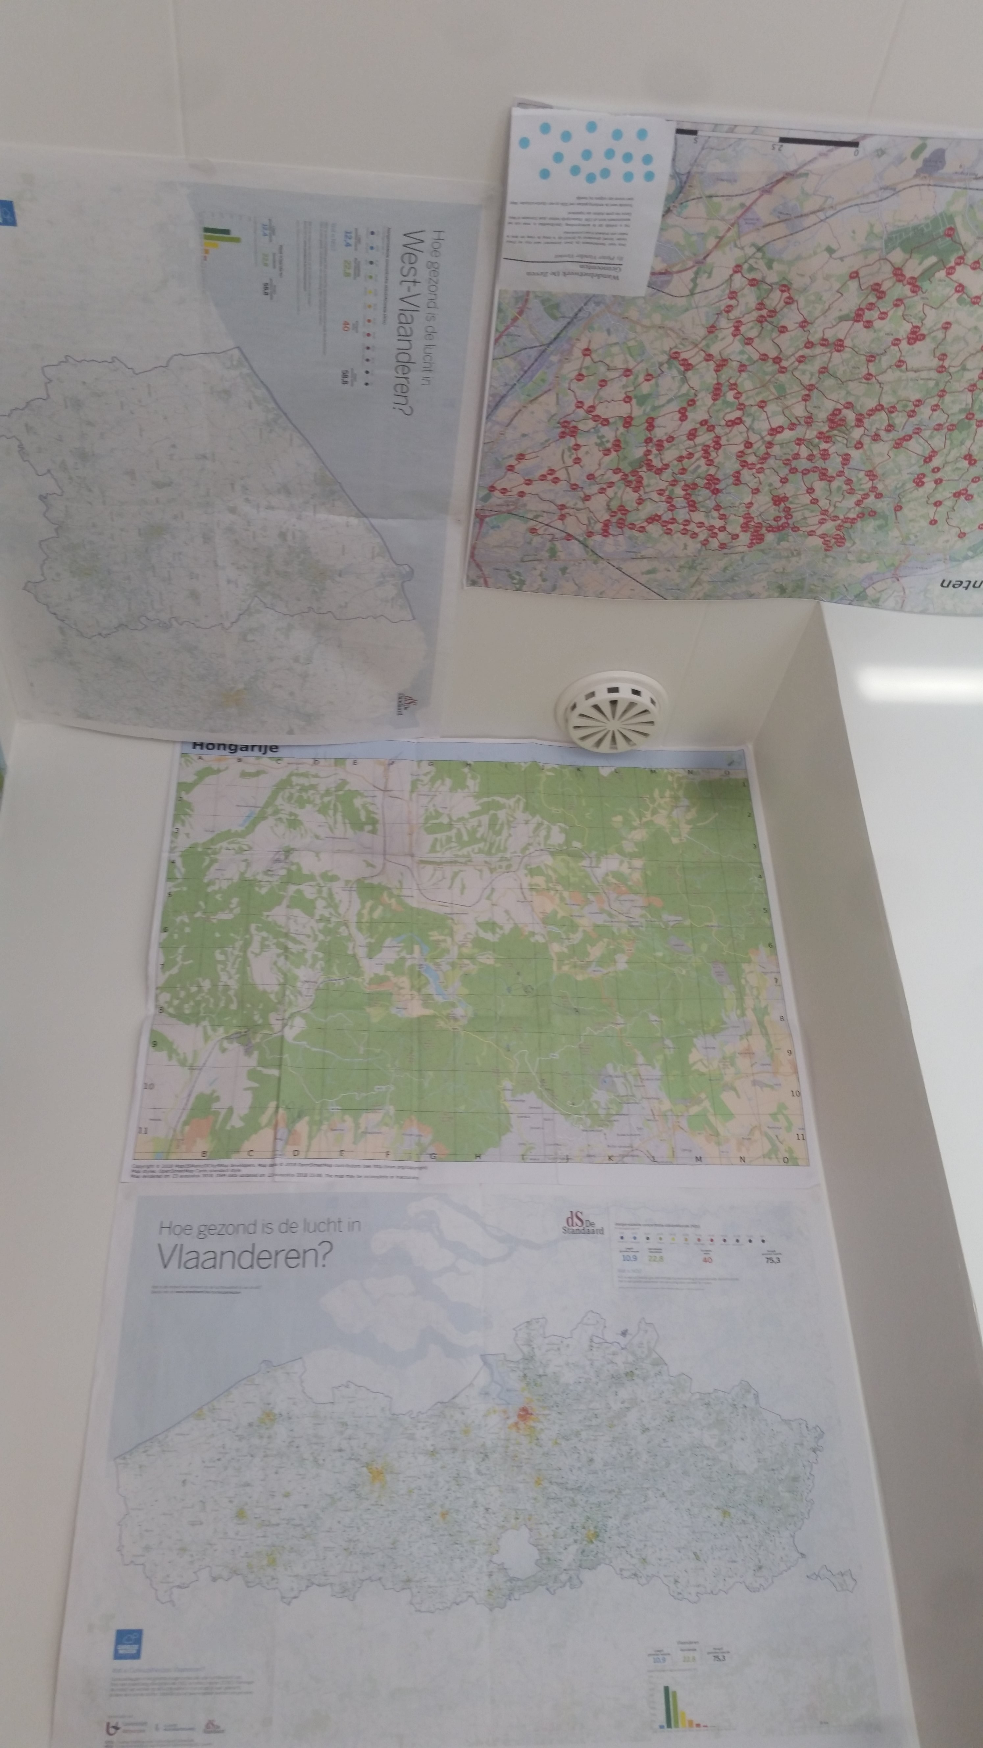
Szell, M. (2018). Crowdsourced Quantification and Visualization of Urban Mobility Space Inequality. Urban Planning, 3(1), 1-20. doi:http://dx.doi.org/10.17645/up.v3i1.1209

Slide 44
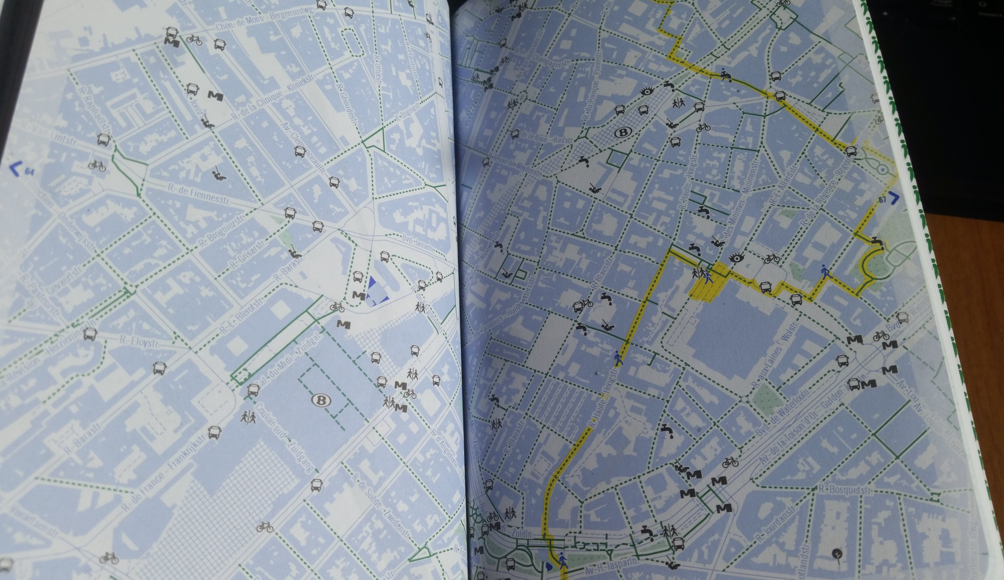


Szell, M. (2018). Crowdsourced Quantification and Visualization of Urban Mobility Space Inequality. Urban Planning, 3(1), 1-20. doi:http://dx.doi.org/10.17645/up.v3i1.1209

Slide 45
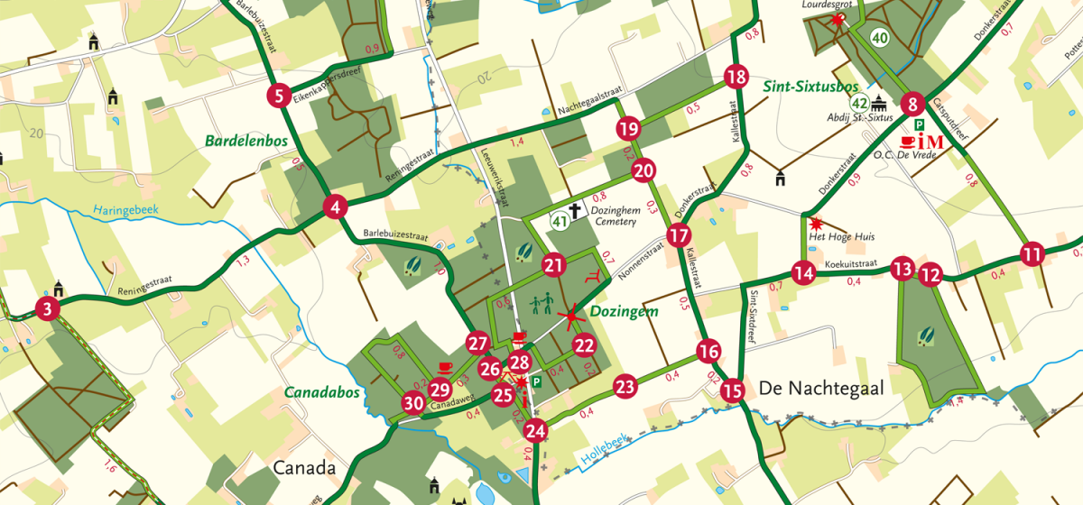

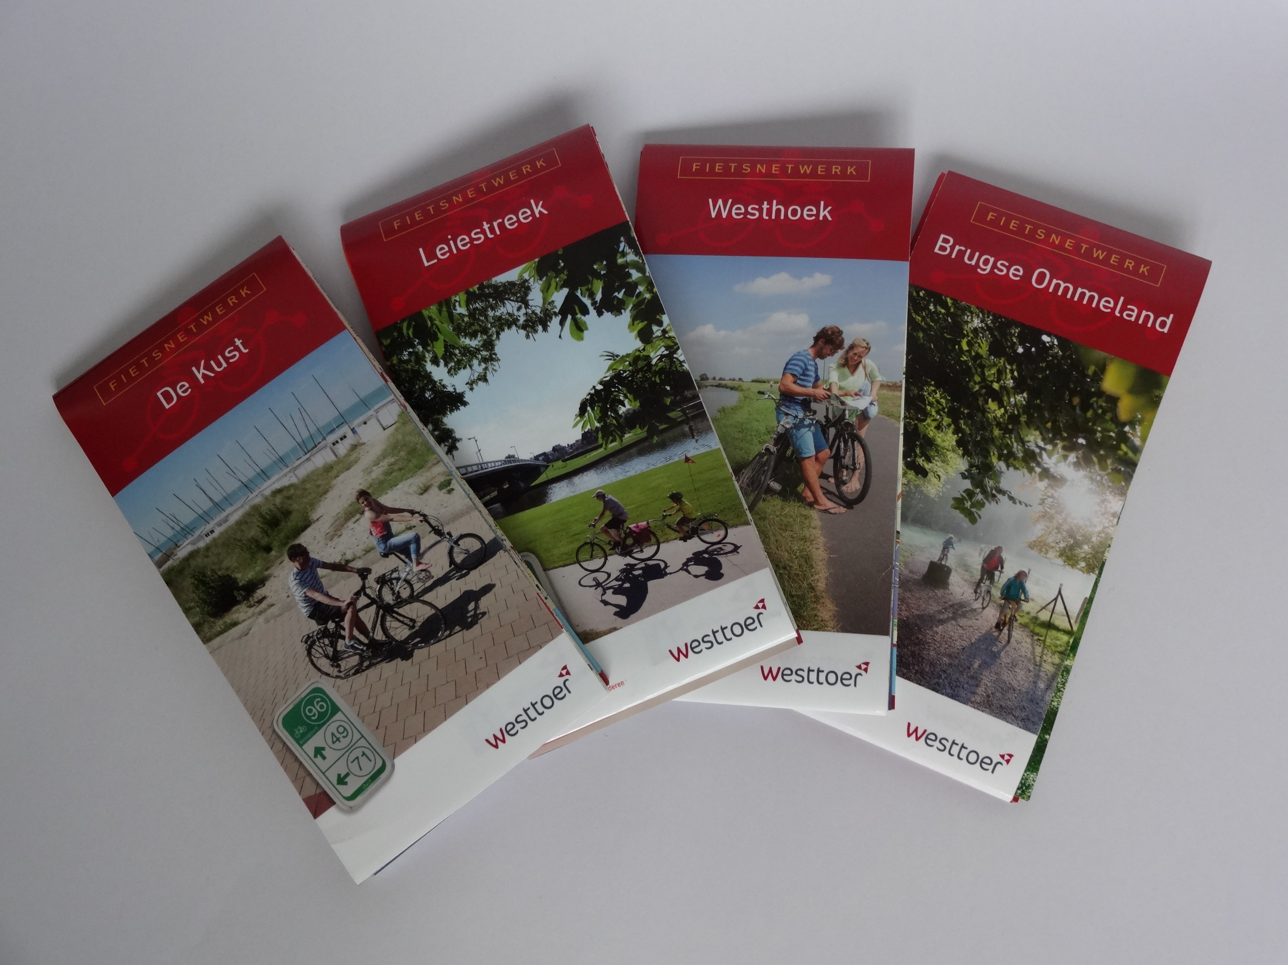
Szell, M. (2018). Crowdsourced Quantification and Visualization of Urban Mobility Space Inequality. Urban Planning, 3(1), 1-20. doi:http://dx.doi.org/10.17645/up.v3i1.1209

Slide 46
When did you last use a map?
Which map was it?
Why?
How much did you pay to use it?

Slide 47

What is
OpenStreetMap
NOT?

Slide 48
What is OSM not?
Profit-oriented
Expensive
Privacy-violating

Slide 49
Price of maintaining a map
Google Maps costs around
  ??? dollar/year

Slide 50
Price of maintaining a map
Google Maps costs around
  1 ‘000’000’000 dollar/year
  (This number is a rumor, no official sources exist)

Slide 51
Price of maintaining a map
Google Maps costs around
  1 billion dollar/year
  (This number is a rumor, no official sources exist)

Slide 52
Price of maintaining a map
Google Maps costs around
  1 billion dollar/year
  (This number is a rumor, no official sources exist)
Buying and creating satellite and map data
Google Streetview costs between $200 and $1150/km
Google bought Waze for 1.1 billion dollar
Nokia bought Navteq for 8 billion dollar and ‘burns’ 1 billion a year
Apple burns around 1 billion dollar/year as well

Slide 53
Price of maintaining a map
Similar amounts for other services
Google bought Waze for 1.1 billion dollar
Nokia bought Navteq for 8 billion dollar
and ‘burns’ 1 billion a year
Apple maps burns around 1 billion dollar/year

Slide 54

How much did you pay?
There is no such thing as free lunch

Slide 55


Slide 56
Notes:
Why are these shown? Why not a very recognizable spot? Such as the stations?

Slide 57

Google Maps is advertising
Google makes money by
placing ads on the map
giving some venues more priority in search
No incentive to map poor countries
“Google Maps only works within 100 miles of a starbucks”
Notes:
Who remembers this

Slide 58

Google Maps is tracking
Google tracks your searches and location through maps,
under the guise of features
“Share your location”, “Find my phone”, “Where am I?”
Very valuable information
Better ads
How effective is an ad pin?
...
Notes:
Who remembers this

Slide 59
Google Maps is a monopoly
Little incentive for other companies to provide cartography services,
cause ‘google maps is free anyways’ - the consumer
You can look to it, but not reuse anything
Google Maps uses lock-in-tricks
  Sudden price hike for devs (1th may 2018)
  Death by a thousand papercuts

Slide 60
… but
Google Maps does have more information
on shops and businesses
because everyone searches them there
(It’s even worse – a shop not on Google
“does not exist)
but this is changing!

Slide 61
… but
Google Maps does have more information
on shops and businesses
because everyone searches them there
(It’s even worse – a shop not on Google
“does not exist)
but this is changing!

Slide 62

OSM is catching up!
2007 2017

Slide 63
OSM is truly free
Free as in beer*
Free as in freedom
However, if you can afford it, donate back
Money for the server
Data – contribute yourself
Love – use it on the road and in your projects
Users – spread the word
*There are commercial, paid solutions too for heavy map users
However, as there are multiple players, it is affordable

Slide 64
What is
OpenStreetMap?

Slide 65
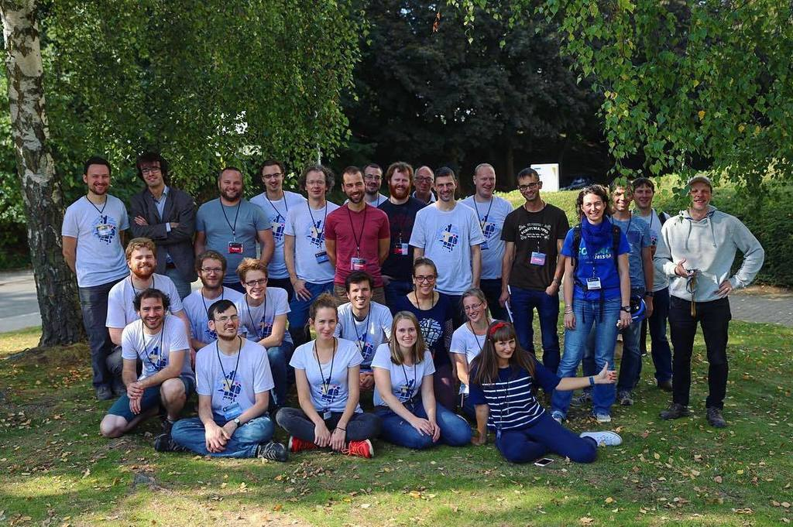

Community

Slide 66
Road completion
Are all the roads listed by the government on our map?
Yes

Slide 67
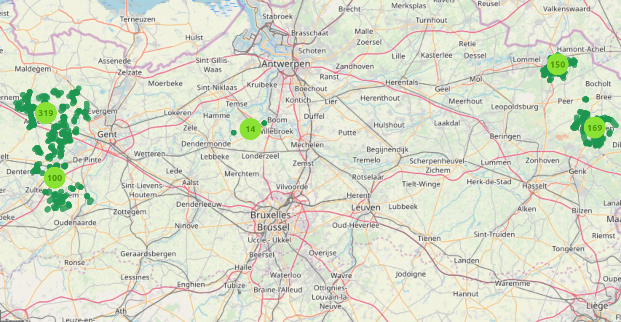
Municipality merges
A few Flemish municipalities merged on 2019-01-01
We prepared everything and had the data online

Slide 68
The Belgian community does stuff
Osm.be
Find us on meetup.com
Talk to us on riot.im (OSMBE - community)
Donate so we can buy 360° camera’s, stickers, vests, servers, …
Help our projects (map historical data, public bookcases, ...)

Slide 69
What is
OpenStreetMap?

Slide 70
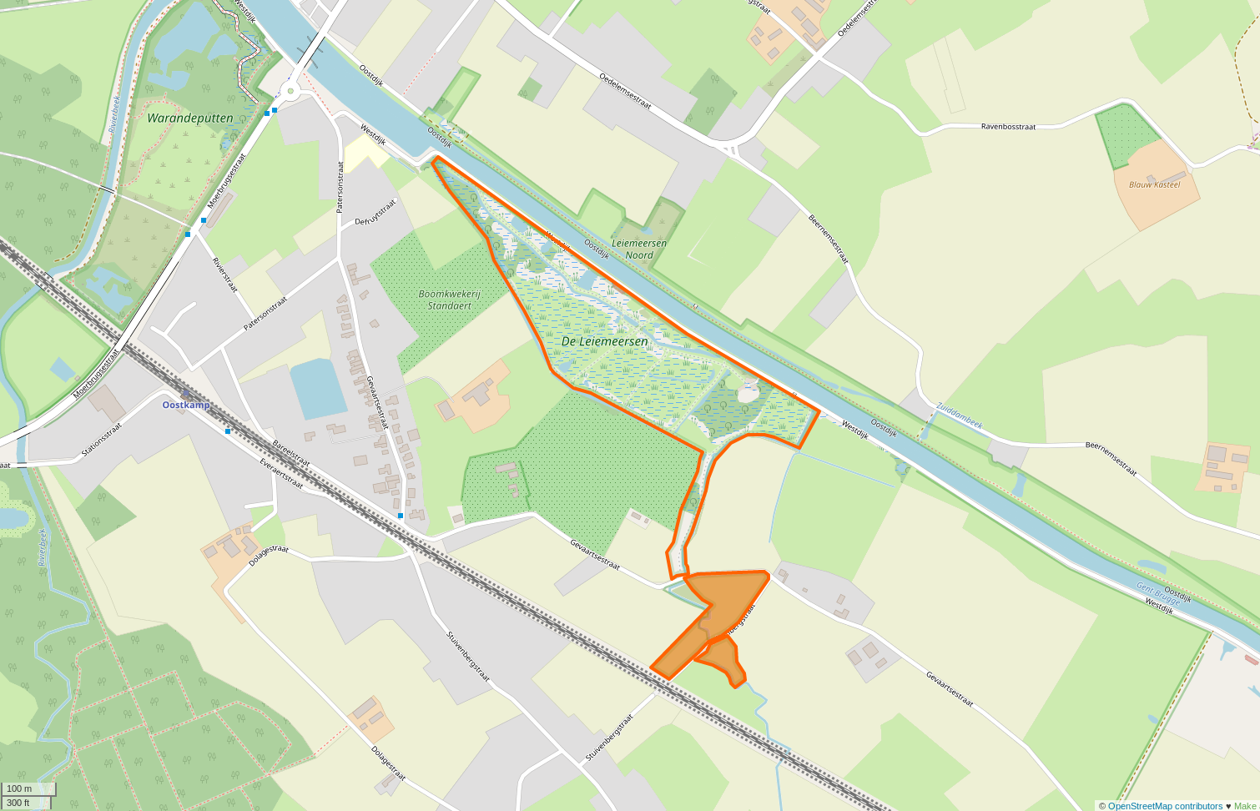
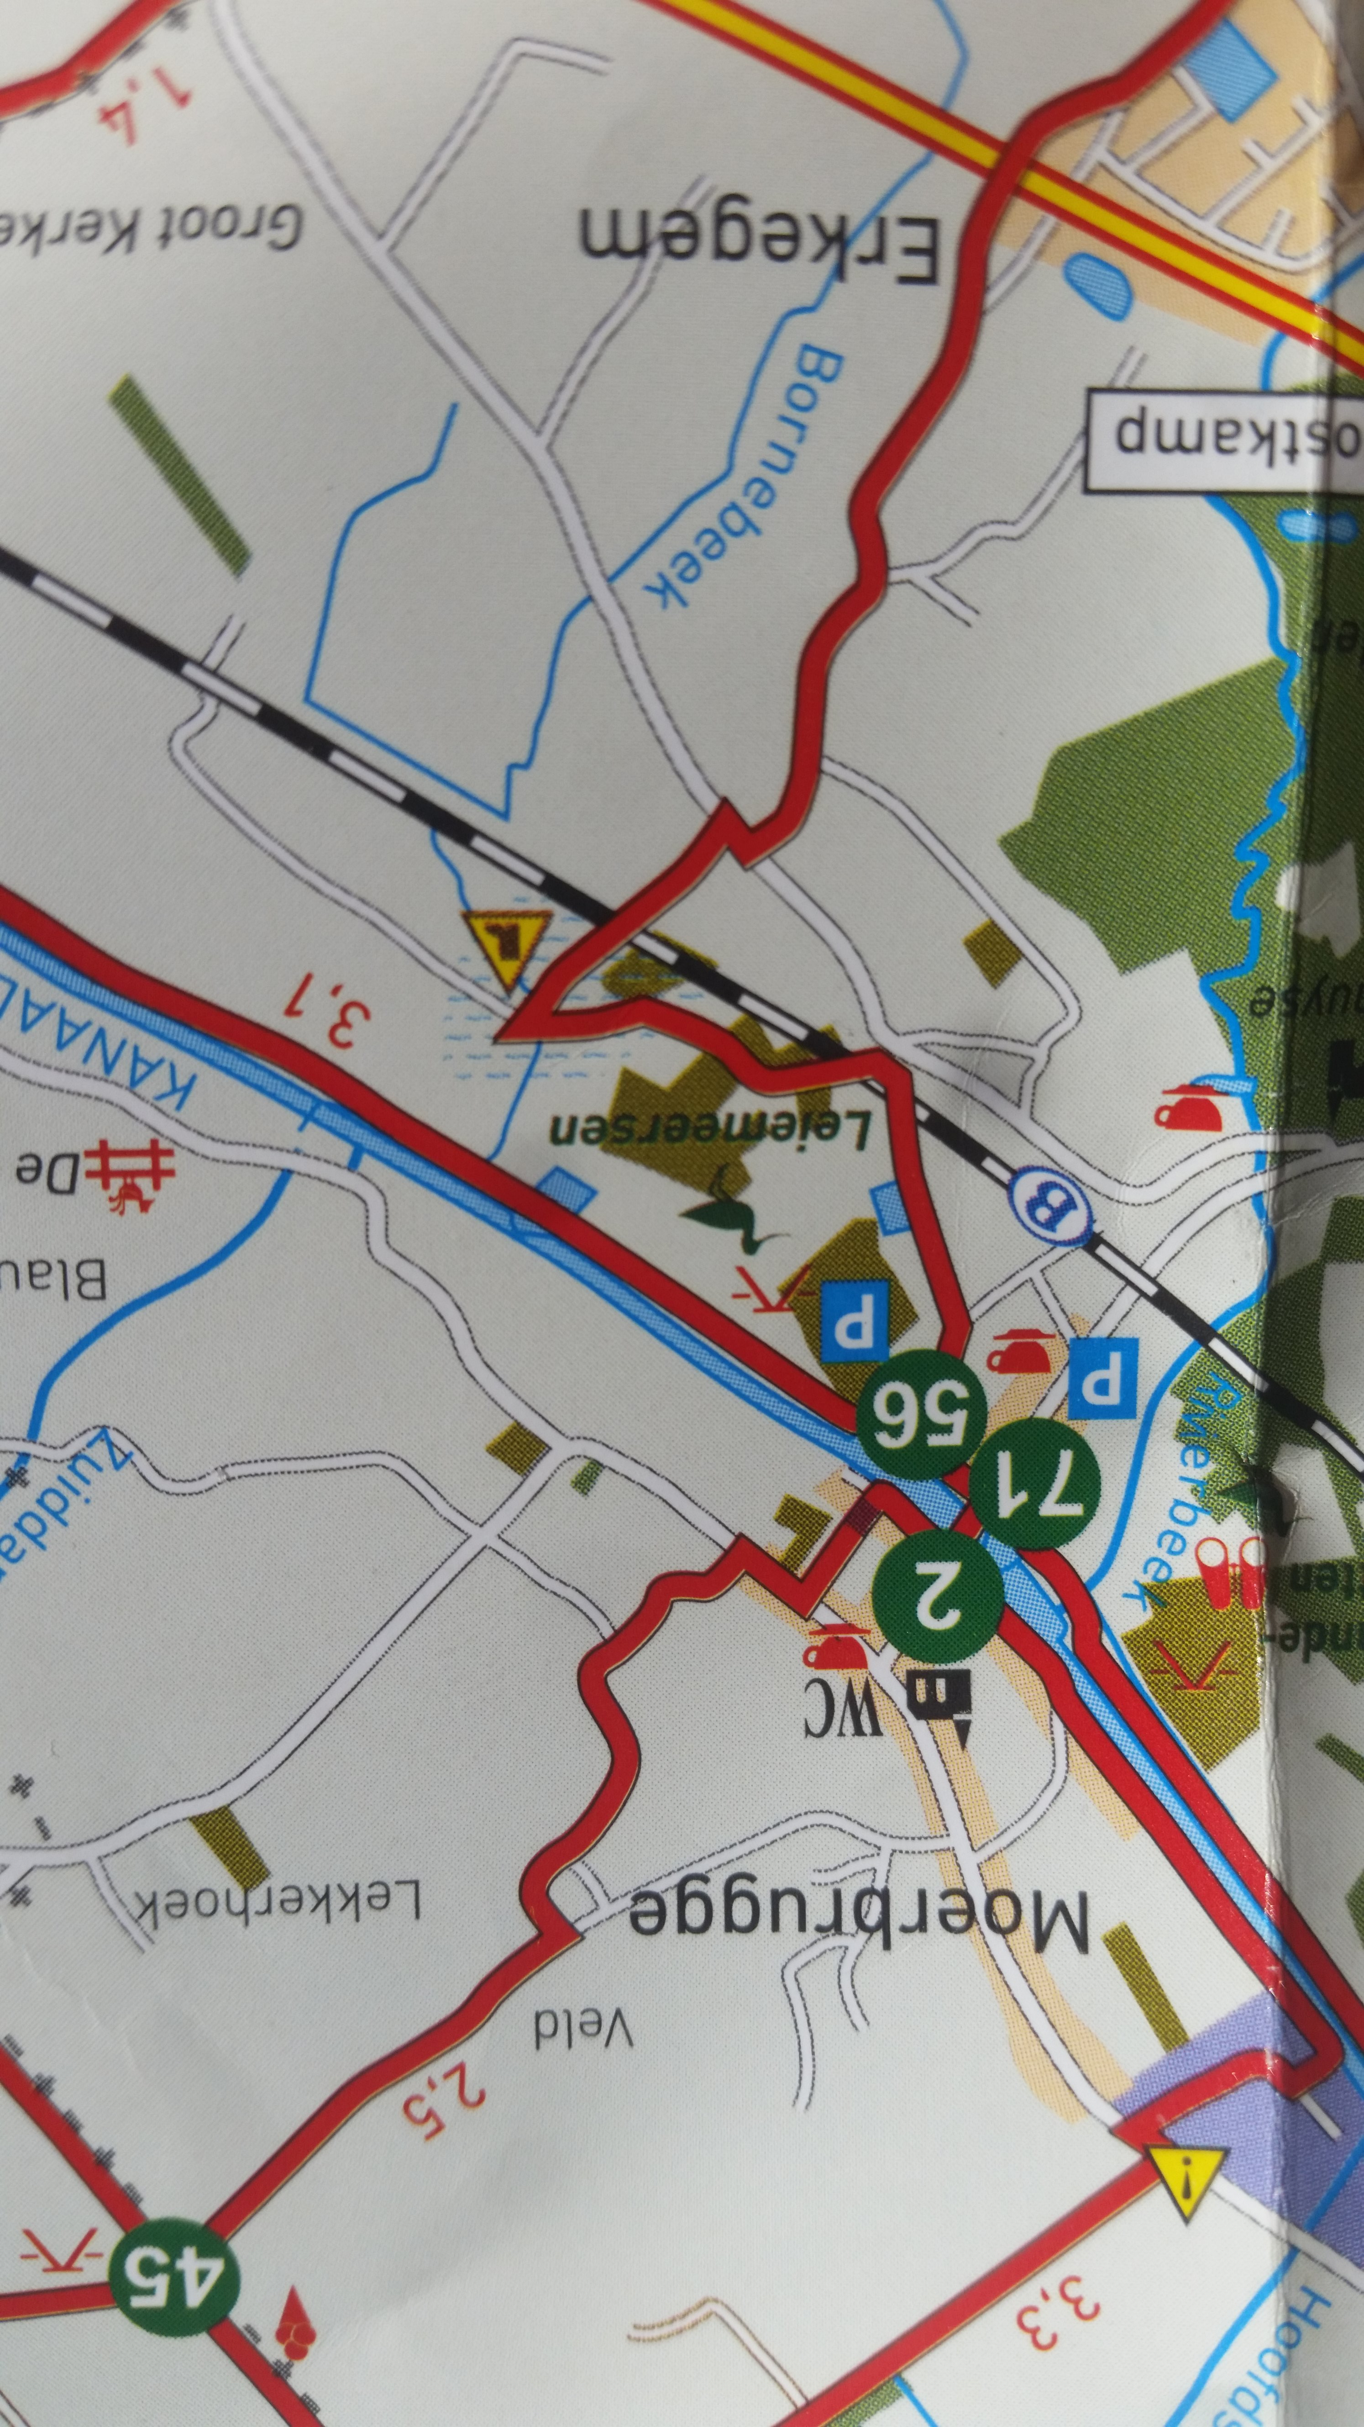
Bought in 2018
© Westtoer, 2016
Basemap: NGI

Slide 71
Working together

Slide 72
Working together on the most accurate, most up-to-date, and most open world map

Slide 73
Working together on the most accurate, most detailed most up-to-date and most open global map and I’m crazy about it

